Slide 1
Ruby on Rails
Tutorial

Slide 2
Objective
Develop an application for the citizens of Karachi to share societal complains/issues

Slide 3
Key Components
User registration/login
Users can capture photo, select a location and category of problem to post
Other users can browse through the problems
If an issue is resolved, admin can flag that post as solved

Slide 4
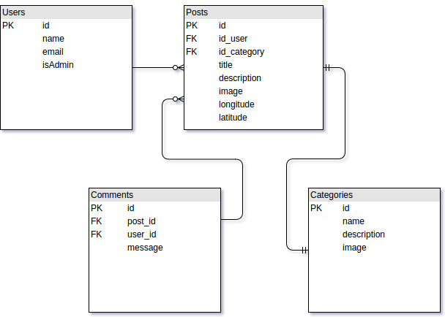
Visualizing scenario

Slide 5
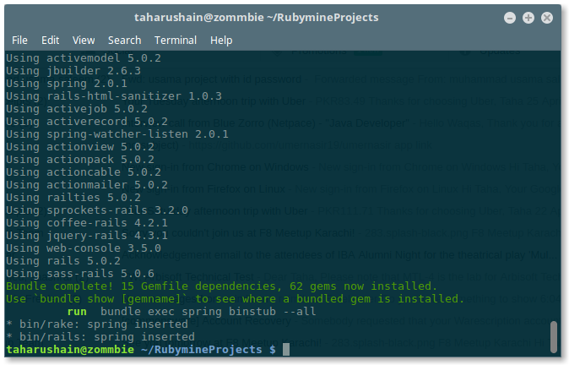
Starting
rails new tutorial
cd tutorial

Slide 6
Categories
Lets start off by creating categories
We can let scaffold do all the dirty work for us.

Slide 7
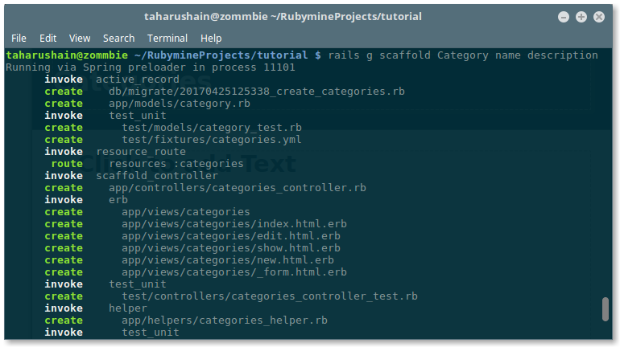
Categories
Rails g scaffold Category name description

Slide 8
Categories
After running the migrations, our category model has a name and description but we also need an image.
For this, we are going to use a ruby gem called ‘CarrierWave’
Goto: https://github.com/carrierwaveuploader/carrierwave

Slide 9
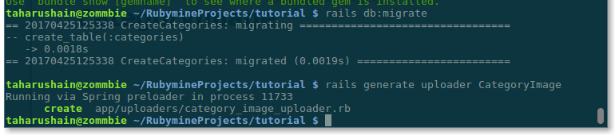
Categories
gem 'carrierwave', '~> 1.0'
rails generate unloader CategoryImage
That creates an ‘uploader’ for categories’ image

Slide 10
Categories
For compressing the images, we would need another gem
gem "mini_magick"
To use this gem, make sure ImageMagick or GraphicsMagick is installed

Slide 11
Categories
Next, we need to add a column in our categories table to hold an image
rails g migration add_image_to_categories image:string
rake db:migrate
Now, we need to make changes to our model file

Slide 12

Categories

Slide 13
Categories
Create /config/initializers/carrier_wave.rb
Add this line to this file
require 'carrierwave/orm/activerecord'

Slide 14
Categories
Next uncomment following line from your image uploader file
include CarrierWave::MiniMagick
Also, uncomment the following
version :thumb do
process :resize_to_fill => [50, 50]
end

Slide 15
Categories
Uncomment the following as well
def extension_white_list
%w(jpg jpeg gif png)
end

Slide 16
Categories
Change your Categories controller’s category_params method to look like this

Slide 17
Categories
Now, we need to add an option to our form for image upload.
Goto /app/views/categories
Modify _form.html.erb
Add
<%= f.file_field :image %>

Slide 18
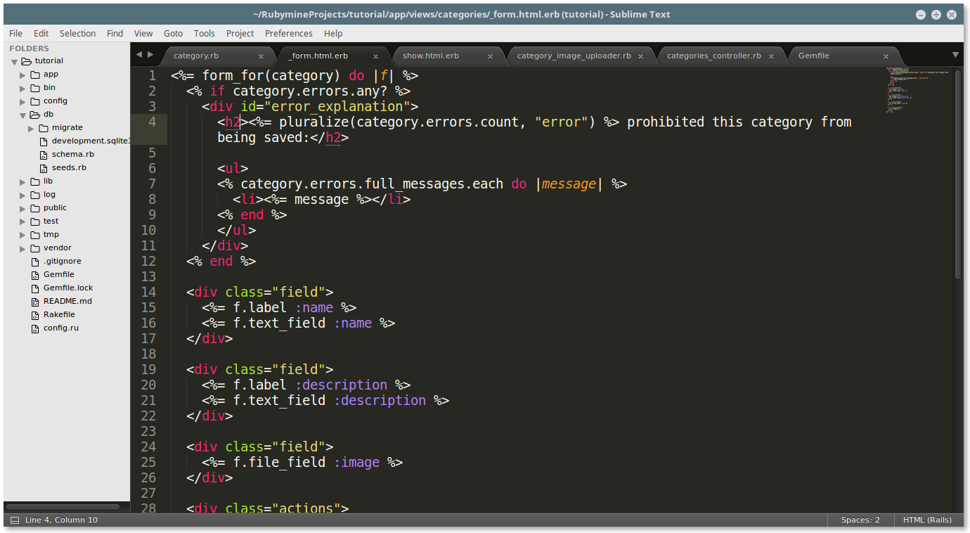
Categories

Slide 19
Categories
So far, we can upload the category images but images are meant to be displayed.
For that, we need to modify
/app/views/categories/show.html.erb

Slide 20
Categories
Insert this code in your show file
<%= image_tag @category.image_url.to_s %>

Slide 21
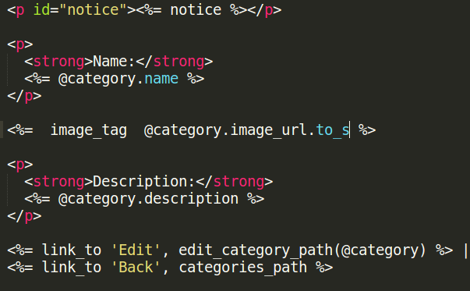
Categories
It should look something like this:

Slide 22
Categories
Ok! So now we have a basic structure for our categories.
Next we need to create Users
But before we dive further in, lets draw some wire-frames to have some guidelines

Slide 23
Wireframes

